Slide 1

Branch Diver Lectures

Slide 2
Version History – hidden slide
Version | Date | Who | What changed
2.0 | Sep06 | HQ | Released as Version Sport Diver Lecture 1 – Basic Equipment
3.0 | Jun12 | HQ | Updated for revised HQ address and contact details
4.0 | Apr14 | Alastair McCulloch | Updated to reflect new Training Schedule with addition of Branch Diver Grade. Lecture renumbered as BDL6 to match the new syllabus. SSAC changed to ScotSAC throughout. Added hidden version history slide. Email address for feedback added to closing slide. Added footers with Lecture number and Page number to slides.

Slide 3
Lecture BDL6
Burst lung and ascents in emergency (basic respiration, anoxia and hypoxia)

Slide 4
Overview
Basic Respiration
  Lungs, Anoxia Hypoxia
Pulmonary Pressure Damage
Cause, signs, symptoms and treatment
  Air embolism
  Pneumothorax
  Emphysema
  Pulmonary tissue damage
Emergency ascent
  Buoyant
  Assisted
  Free

Slide 5
What is respiration?
Respiration is the process by which Oxygen is extracted from the air we breathe and transported to the tissues by our blood
The human body needs Oxygen to release the chemical energy from food in the same way that fire needs Oxygen to burn
This process is known as metabolism.
Carbon Dioxide (CO₂) is produced as a waste product of this process
Food + O2 = Energy + CO2 +WASTE PRODUCTS

Slide 6
Respiration
During the metabolism process only a small amount of the oxygen in air is actually used
Nitrogen is NOT involved in the metabolic process
Inhaled Air Exhaled Air
Oxygen 21% 16%
Nitrogen 78% 78%
Carbon dioxide Trace 5%
Other Gases ~ 1% ~1%

Slide 7
Respiration
How do we breathe?
Like a pair of bellows the action of the intercostal muscles and the diaphragm suck air in and out
To breathe in, the rib muscles contract to pull ribs up and out. The diaphragm moves downward enlarging the chest cavity. Reduced pressure in the lungs causes air to rush into the lungs
When breathing out, the rib muscles relax like a spring. The chest cavity is returned to it's original volume forcing out the air

Slide 8
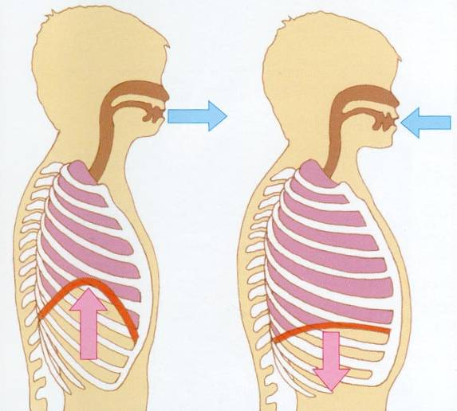
Respiration - Breathing
source NHS Borders
Breathing out
Breathing in

Slide 9
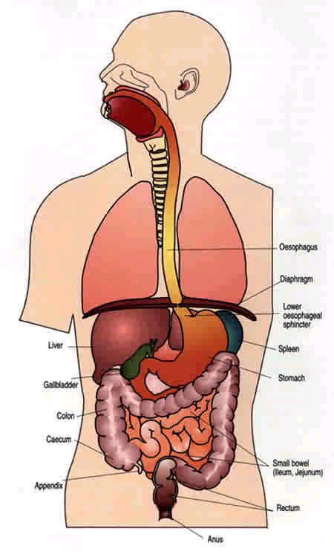
Respiration
Air enters through the nose or mouth and passes the pharynx, larynx and trachea before passing into the lungs
WWW.PNC.COM.AU/TALLEY/IMAGES

Slide 10
Lungs
Inside the lungs are tubes, called Bronchi, which branch into even smaller tubes
At the end of these tubes are millions of tiny sacs or bubbles called Alveoli. There are about 600 million in an average adult
Their function is to allow the transfer of Oxygen through the Capillaries to the blood and Carbon Dioxide from the blood to the air

Slide 11
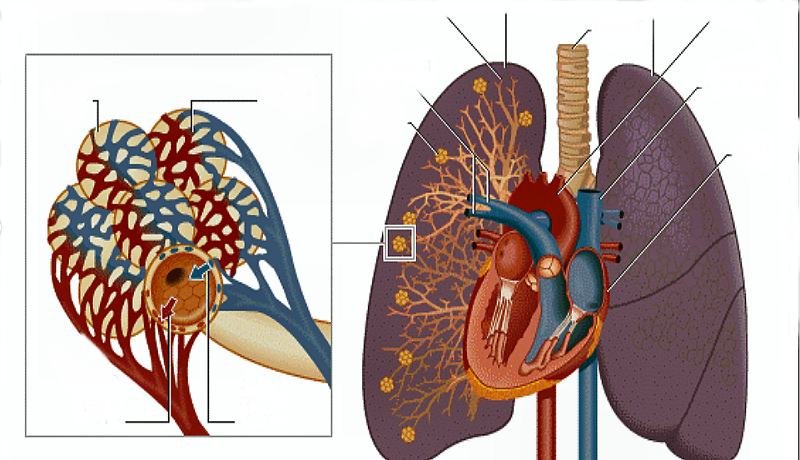
Lungs
bronchiole
lungs
lungs
aorta
trachea
Pulmonary
arteries
Superior
Vena cava
alveoli
capillary
alveoli
heart
Oxygen enters
alveoli
Co2 leaves
veins
source NHS Borders

Slide 12
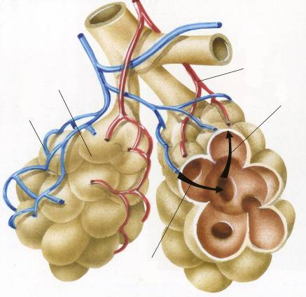
Gas Exchange
Oxygen diffuses through the Alveoli to the Capillaries. Only about 0.002mm separate the alveoli from the capillaries due to the thin walls
Oxygenated blood
alveolus
oxygen
Deoxygenated blood
Carbon
dioxide
source NHS Borders

Slide 13
Lung Capacity
The total volume of air that the lungs can hold varies with the size of the person – the average person can hold about 6 litres
At rest only 0.5 litre is breathed in and out with each breath- this is known as the tidal volume
Vital Capacity is the maximum amount of air we can breathe in one breath – normally around 4.5 litres
The difference between total and residual lung capacity is known as the residual volume –normally c. 1.5 litres
Residual volume is of importance to snorkel divers. A diver with full lungs on surface (6 litres at 1 bar) will have only 1.5 litres at 30m After this point the volume of air in the lungs becomes less than the residual volume and the increased pressure compresses the chest and may lead to lung damage

Slide 14
Breathing
Breathing is triggered by Carbon dioxide NOT by Oxygen
As our body uses oxygen, carbon dioxide is produced and builds up, triggering the body to breathe
It is the pH level of the blood that signals to the brain it is time to breath. When Carbon dioxide dissolves in the blood it forms a weak acid called Carbonic Acid
The more carbonic acid in the blood, the lower the pH and the greater the desire to breath

Slide 15
Hypoxia & Anoxia
Demand for oxygen varies with the workload
Hypoxia is defined as a lack of oxygen
Anoxia is defined as an absence of Oxygen
Both can apply to the entire body or to specific organs like the brain
Body cells cannot survive without oxygen
Brain cells are particularly sensitive and can die within as little as 4 minutes

Slide 16
Hypoxia & Anoxia
Hypoxia can occur for a number of reasons
  Airway obstruction
  Low partial pressure of oxygen in the breathing gas. (e.g. less than 0.14bar)
  Lung damage or disease
  Carbon monoxide poisoning
  Heart problems
  Hyperventilation or drowning

Slide 17
Hypoxia & Anoxia
Symptoms of Hypoxia
  Coughing
  Chest pain
  Shortness of breath
  Blue lips, tongue or ear lobes
  Headache
  Unconsciousness
Treatment
  Establish and maintain a clear airway
  Give Oxygen as soon as possible, using pure oxygen if available
  Treat for shock
  Call Emergency Services
  If the victim is not breathing give Rescue Breathing
  If the victim has no circulation start CPR

Slide 18
Pulmonary Pressure Damage
Boyle’s Law states that pressure varies inversely with volume. For a fixed mass of gas, the pressure increases as the volume decreases, and vice versa
500%
A diver who fails to exhale while ascending runs the risk of over expansion of the lungs
Air can be forced into the blood stream or can cause lung tissue to rupture, trapping air in pockets in the chest cavity
Surface
10m
20m
30m
40m
250%
166%
This condition is not preceded by any warning signals, as with the ears, as the ‘full to bursting’ sensation (Hering-Breur reflex) is very weak in human beings
The results of this are dramatic and often fatal. Injuries of this sort are collectively referred to as ‘burst lung
125%
100%

Slide 19
‘Types’ of burst lung
Pulmonary tissue damage
Air embolism
Emphysema
Pneumothorax
WWW.PNC.COM.AU/TALLEY/IMAGES

Slide 20
‘Types’ of burst lung
PULMONARY TISSUE DAMAGE
  This is the rupture of a few alveoli
  It always precedes air embolisms, pneumothorax and emphysema
  Symptoms include breathing difficulties, coughing and bloody sputum
AIR EMBOLISM
  An embolism is a blockage of circulation
  The alveolar membrane can stretch, allowing tiny bubbles of air to enter the capillaries and the bloodstream The circulation will carry these bubbles to the brain, heart and other vital organs
  Bubbles may unite and lodge, blocking further blood flow and oxygen supply
  Symptoms usually appear rapidly after surfacing: giddiness; numbness; paralysis; visual disturbances; respiratory difficulties; heart failure and death are all associated with this type of injury
  This can occur from as little as 3m depth

Slide 21
Spontaneous Pneumothorax
Alveolar tissue may suffer a major tear, allowing considerable quantities of air to escape\outwards and become trapped between the lung sac and chest wall
As the ascent continues, the pressure of the trapped air will be greater than that of the air in the lungs, causing the lung sacs to collapse. The lungs will then be starved of oxygen
Symptoms include severe pain on breathing, shortness of breath, coughing of blood and swollen appearance of chest cage

Slide 22
Interstitial Emphysema
Larger bubbles of air that escape from torn lung tissue can travel inwards between the lung sacs, into the vicinity of the heart and the major blood vessels
This trapped air will also have a serious effect on normal respiration
Symptoms include shortness of breath, swollen appearance of skin at base of neck and also those of air embolism

Slide 23
Treatment for Burst Lung
In all cases, normobaric oxygen should be administered immediately to the victim
The only successful treatment for air embolism is immediate recompression in a chamber
Pneumothorax and emphysema may require minor surgical treatment. Consequently, professional medical assistance should be sought immediately
The victim should be placed with the head lower than the feet, to encourage air away from the heart and brain
If breathing difficulties are experienced, they may be alleviated by administering Rescue Breathing

Slide 24
Prevention
Every diver should successfully undertake a proper medical examination
Diseased lungs are weakened and are therefore more susceptible to damage
During colds, mucous clogs lungs and increases the risk of lung damage if diving is conducted
Most importantly:
ALWAYS BREATHE NORMALLY: NEVER HOLD YOUR BREATH

Slide 25
Ascent Procedures
NORMAL ASCENTS
1. The diver exchanges ‘go up’ signal with buddy. ‘OK’ signals are also exchanged
2. Both divers fin gently upwards whilst monitoring depth gauge/computer, buddy and small bubble ascent rate
3. A rate of 10m/min should not be exceeded. Normal breathing must be maintained at all times. The divers should look up for surface obstacles or other hazards above (e.g. jellyfish)
4. In a poor visibility situation, the diver should hold his/her hand above the head and hold on to buddy
5. As the divers pass the 10 m point, the ascent rate should be carefully controlled
6. At 3m perform safety stop for minimum 1 minute
7. On surfacing, the divers should check all around (360º circle) for approaching vessels
8. The divers should exchange ‘OK’ signals with each other and the boat or shore cover. BCDs may be inflated

Slide 26
Emergency Ascents
These occur most often through poor dive practice and not due to equipment failure. Running out of air is the most common reason
Rapid ascents may cause burst lungs or contribute to decompression sickness. This is covered in a later lecture
(1) Assisted Ascent
  This procedure assumes that the buddy is in close proximity and his/her attention can be attracted quickly
1. The distressed diver gives the “I am out of air” signal
2. The assisting diver (AD) approaches from the right (due to position of regulator) as quickly as possible. The AD gives octopus to buddy and takes hold of buddy’s harness with left hand (diver being assisted takes buddies harness with right hand)
Assisted diver breaths normally from octopus.
When regular rhythm is established, donor gives “up” signal. Ok signal exchanged and ascent begins.
*At time of going to print NDC of 2006 has suspended shared ascent exercises. This page should be updated if situation changes.

Slide 27
Emergency Ascents
(2) Free Ascent (should never be practised)
  Used when contact with buddy cannot be made. This method is dependant on calm, controlled technique for its success
1. The diver immediately begins to fin steadily upwards
2. If this is found to be difficult, the weightbelt can be jettisoned
3. The diver should remove mouthpiece and exhale gently and continuously through pursed lips
4. As the diver approaches 10m, it is essential to start breathing out more rapidly to avoid serious pressure damage
  The feeling of air starvation may diminish slightly if the breath is held BRIEFLY until the residual air in the lungs expands. (Another breath may also be obtained from the regulator)
  After this (or any) type of emergency ascent, the diver should be observed for any signs of pressure damage or decompression sickness

Slide 28
Emergency Ascents
(3) Buoyant Ascent (should never be practised)
  Most ABLJs and STAB jackets are fitted with direct feed and (occasionally) an emergency air cylinder, which can be used to bring a diver to the surface in an emergency
The weight belt must not be removed as it maintains correct body position
The ABLJ/STAB emergency cylinder tap is opened, or the direct feed button is depressed, just sufficiently to begin the ascent
As the ascent commences, the tap/direct feed should be turned off
The diver should lean back, breathe out and look towards the surface
The ascent rate may be controlled by venting the ABLJ/STAB/drysuit Care must be taken not to vent excessively such that the diver becomes negatively buoyant and starts descending again
  NB Full inflation of an ABLJ/STAB induces an ascent rate of 120m/min, which could cause explosive decompression and air embolism

Slide 29
Summary
Basic Respiration
  Breathing
  The lungs
Burst Lung
  Causes
  Types
  Treatment and avoidance
Emergency Ascents
  Assisted
  Buoyant
  Free
NEVER HOLD YOUR BREATH
BUOYANT AND FREE ASCENTS SHOULD NEVER BE PRACTICED!

Slide 30
The End
Thank you for your attention
Any questions?

Slide 31
Please provide any feedback on these slides to hq@scotsac.com
Thanks.

